Slide 1



Slide 2
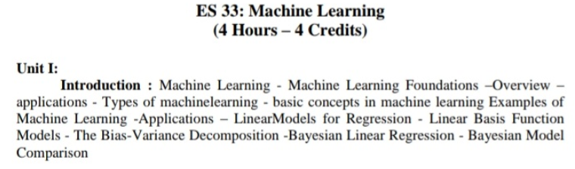
As per Machine Learning syllabus

Slide 3



Slide 4
“Learning is any process by which a system improves performance from experience.”
- Herbert Simon
Definition by Tom Mitchell (1998):
Machine Learning is the study of algorithms that
improve their performance P
at some task T
with experience E.
A well-defined learning task is given by <P, T, E>.

Slide 5
Traditional Programming
Data Program
Computer
Output
Machine Learning
Data Output
Computer
Program

Slide 6


Slide 7

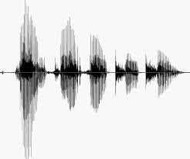

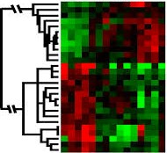
ML is used when:
Human expertise does not exist (navigating on Mars)
Humans can’t explain their expertise (speech recognition)
Models must be customized (personalized medicine)
Models are based on huge amounts of data (genomics)

Slide 8


Slide 9
Web search
Computational biology
Finance
E-commerce
Space exploration
Robotics
Information extraction
Social networks
Debugging software
[Your favorite area]

Slide 10


Slide 11
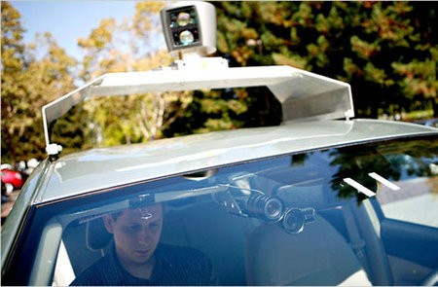
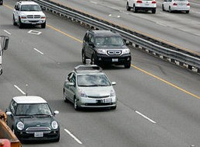
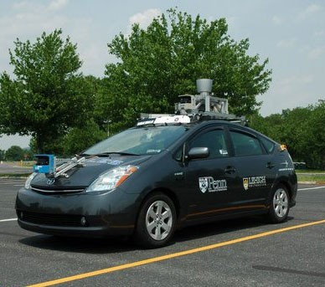
Nevada made it legal for autonomous cars to drive on roads in June 2011
As of 2013, four states (Nevada, Florida, California, and Michigan) have legalized autonomous cars
Penn’s Autonomous Car 🡪(Ben Franklin Racing Team)

Slide 12


Slide 13
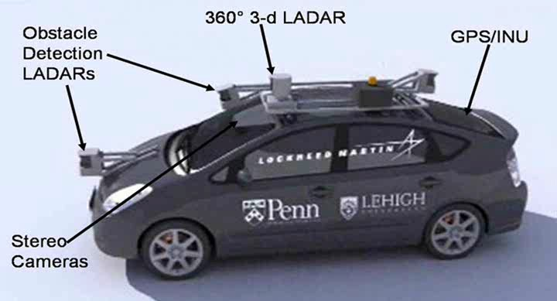

Slide 14


Slide 15
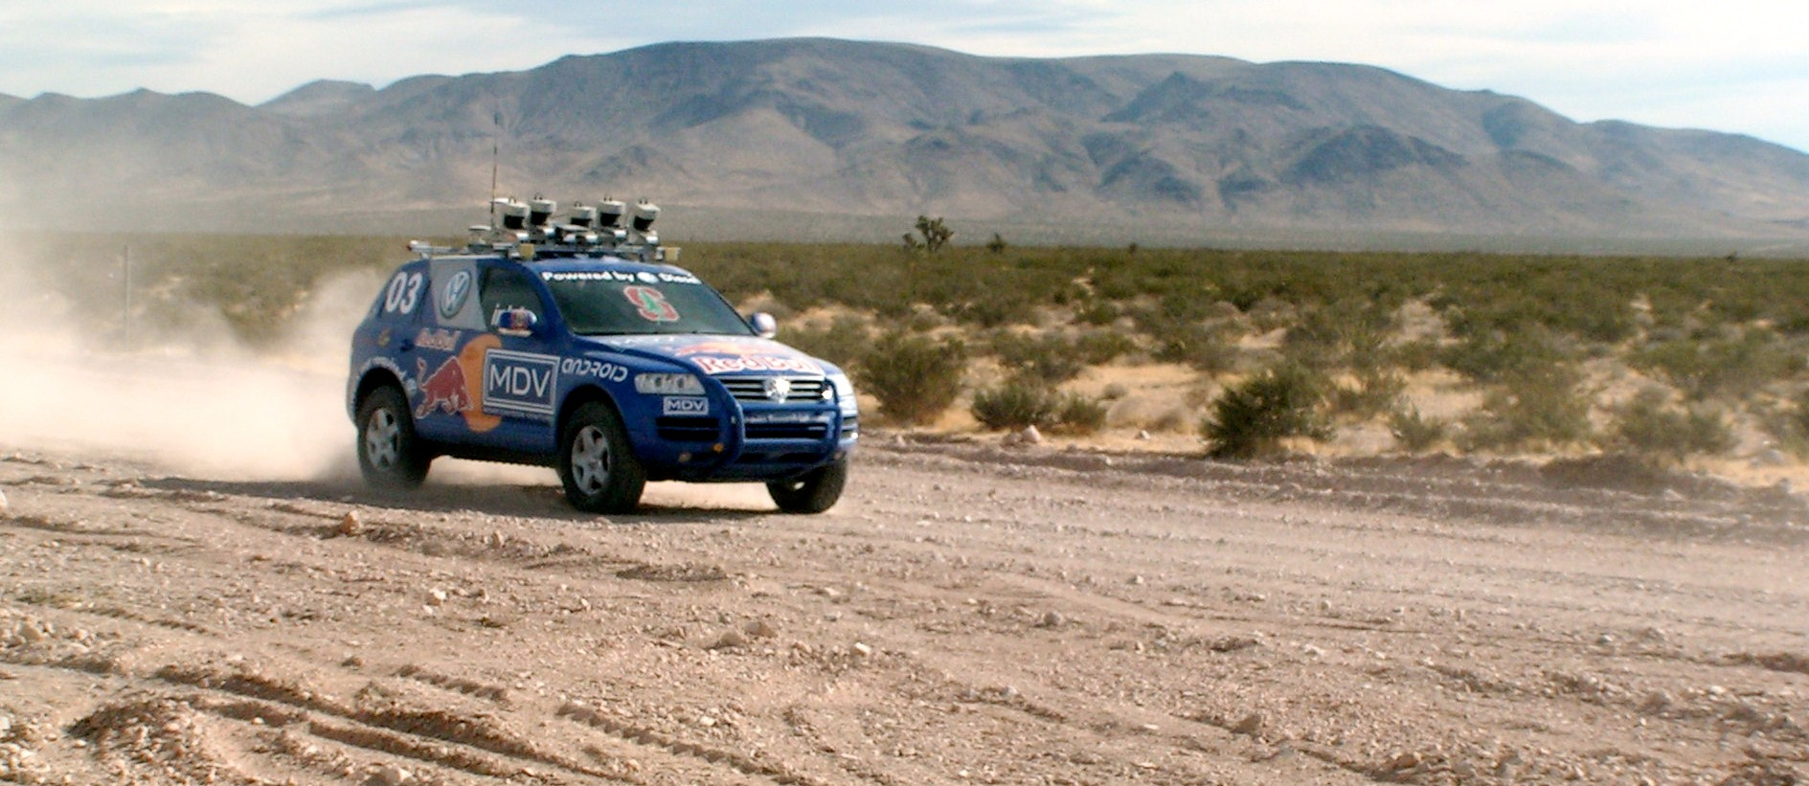
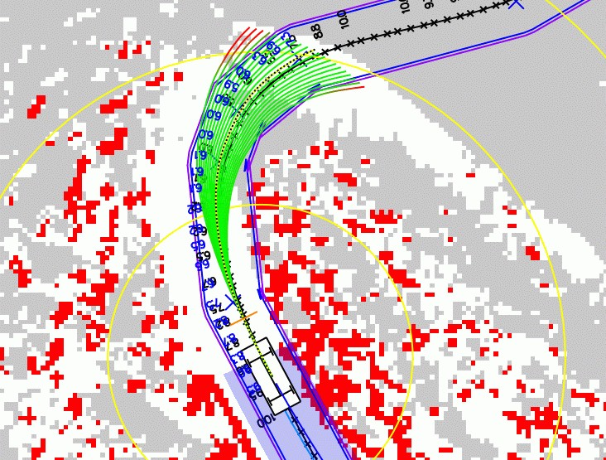
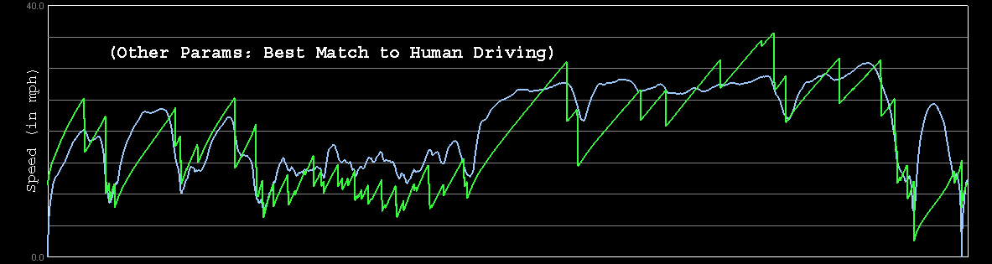

Path Planning
Laser Terrain Mapping
Learning from Human Drivers
Sebastian
Adaptive Vision
Stanley

Slide 16


Slide 17
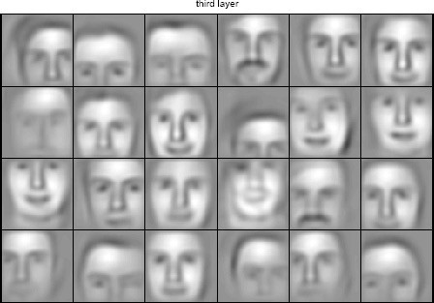
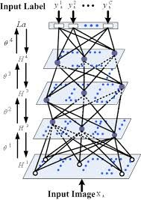

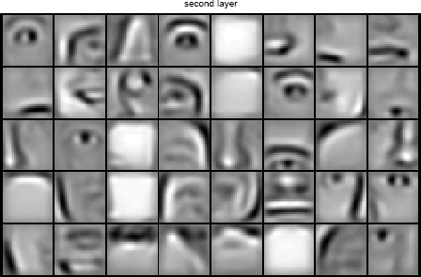







object models
object parts (combination of edges)
edges
pixels

Slide 18


Slide 19
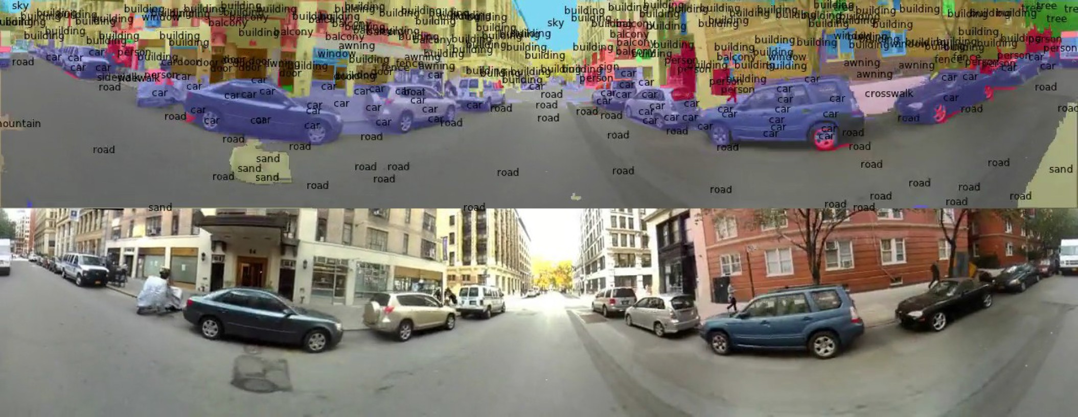

Slide 20


Slide 21
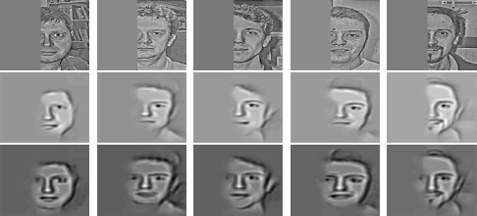
Generating posterior samples from faces by “filling in” experiments
(cf. Lee and Mumford, 2003). Combine bottom-up and top-down inference.
Input images
Samples from feedforward Inference (control)
Samples from Full posterior inference

Slide 22


Slide 23








Slide 24


Slide 25
Supervised learning
Unsupervised learning
Reinforcement learning

Slide 26


Slide 27
Accuracy
Precision and recall
Squared error
Likelihood
Posterior probability
Cost / Utility
Margin
Entropy
K-L divergence
etc.

Slide 28



Slide 29



